Slide 1

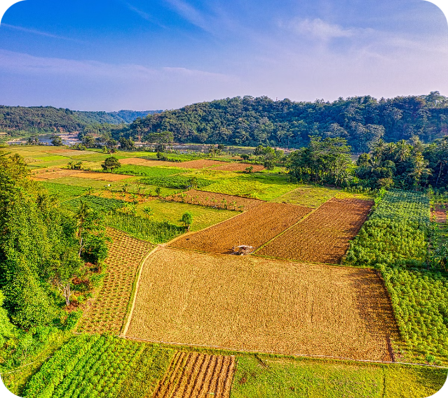
Introduction to Crop Yield Prediction and Estimation
Crop yield prediction and estimation are critical for resource management, and economic planning. By leveraging crop statistics FAO, we can develop advanced models to accurately forecast crop yields and support decision-making in the agricultural sector.

Slide 2

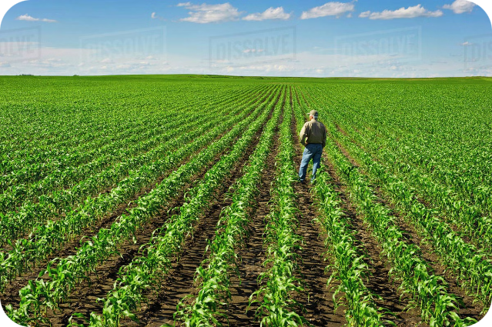
Importance of Accurate Crop Yield Forecasting
1
Food Security
2
Economic Planning
Accurate yield forecasts help ensure adequate food supply and guide distribution efforts.
Yield predictions support pricing, trade, and investment decisions for agricultural commodities.
3
Resource Management
Yield estimates guide efficient allocation of inputs like land, water, and fertilizers.

Slide 3


Leveraging Time-Series Remote Sensing Data
1
Data Acquisition
Collect multi-temporal satellite imagery and weather data to build a comprehensive dataset.
2
Feature Engineering
Extract relevant crop-specific features from the time-series data, such as vegetation indices and climate variables.
3
Model Development
Apply machine learning techniques to train predictive models that can forecast crop yields.

Slide 4
Challenges in Crop Yield Modeling
Data Availability
Crop Heterogeneity
Extreme Events
Limited access to high-quality, comprehensive datasets can hinder model development.
Crop characteristics and growing conditions can vary significantly within a region.
Accurately modeling the impact of droughts, floods, and other extreme weather events on yields is complex.

Slide 5

Methodologies for Crop Yield Prediction
Regression Models
Machine Learning
Using statistical techniques to correlate remote sensing and meteorological data with historical yield records.
Applying advanced algorithms like neural networks and random forests to learn complex yield-influencing patterns.
Process-based Models
Hybrid Approaches
Simulating the underlying biophysical processes that govern crop growth and development.
Combining multiple modeling techniques to leverage their respective strengths and improve prediction accuracy.

Slide 6
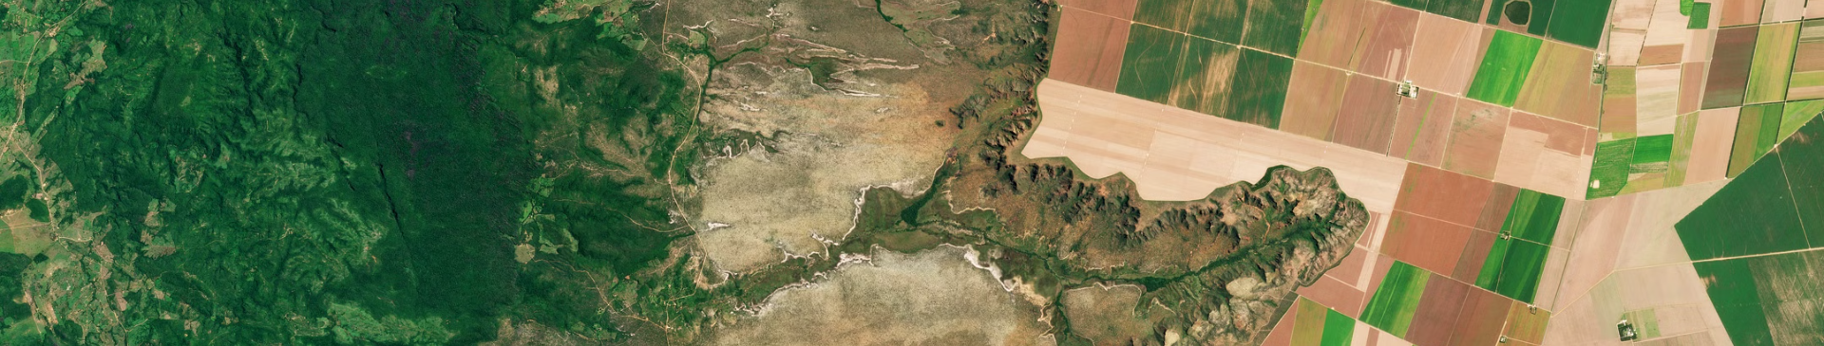



Integrating Crop Sensing and Meteorological Data
Soil Data
Climate Data
Data Fusion
Provides various information on crop conditions, vegetation, and soil data.
Captures the influence of temperature, precipitation, and other meteorological factors on crop growth.
Integrating multiple data sources to build comprehensive, high-resolution models.

Slide 7


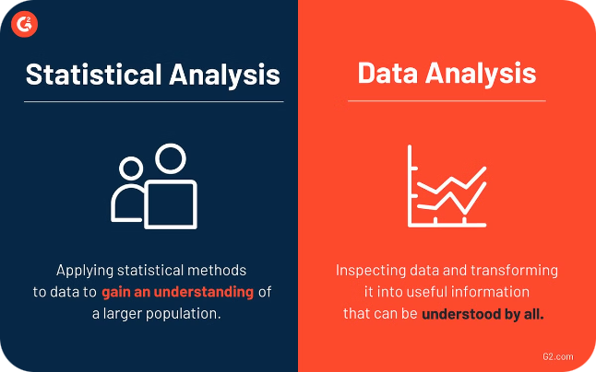


Validation and Accuracy Assessment
Ground Truthing
Collect field-level data to validate model predictions and identify areas for improvement.
Error Analysis
Assess the magnitude and sources of model errors to refine algorithms and data inputs.
Cross-Validation
Test model performance on independent datasets to ensure robust and generalizable predictions.

Slide 8
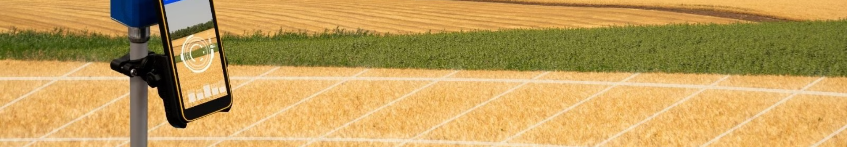
Applications and Future Directions
Precision Agriculture
Optimize farm-level management decisions based on site-specific yield forecasts.
Policy Planning
Support national and regional food security strategies through robust yield projections.
Climate Adaptation
Develop models to assess the impact of climate change on agricultural productivity.
Global Monitoring
Establish early warning systems to detect and respond to crop production anomalies.

